Slide 1

Web-Server Programming
JSON
2016.03.11 (Fri)

Slide 2
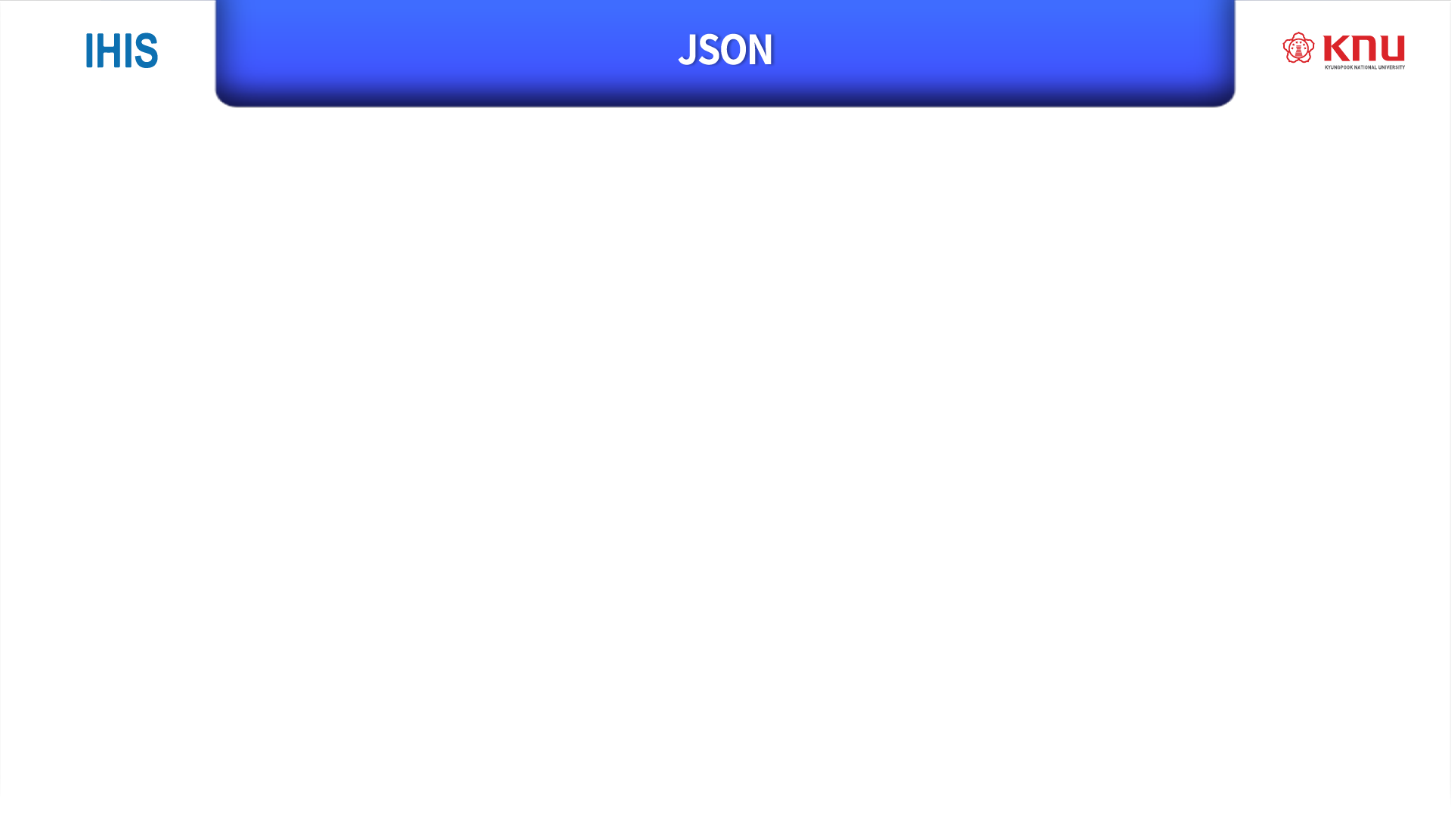
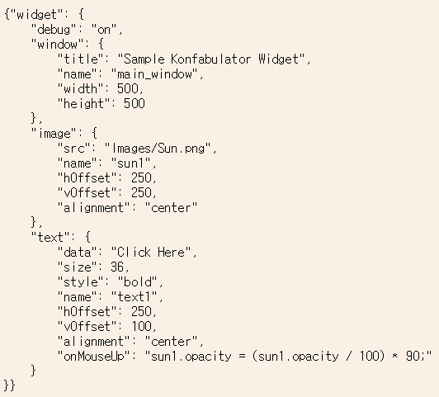
JavaScript Object Notation
Syntax for storing and exchanging
Data-interchange format
File extension “file.json”

Slide 3
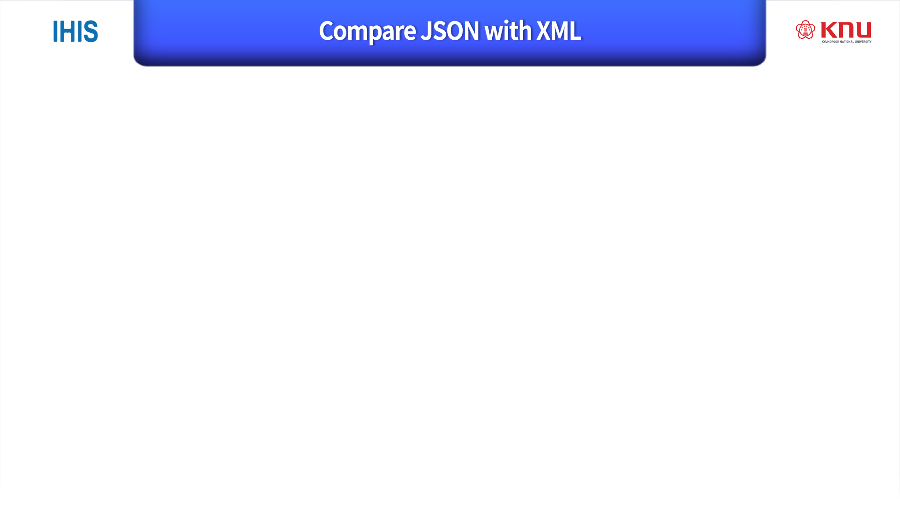
They are both :
Self describing
Hierarchical
Can be used by many languages
They are different :
 | JSON | XML
End tag | X | O
Length | short | long
Speed | quick | slow
Array | O | X

Slide 4
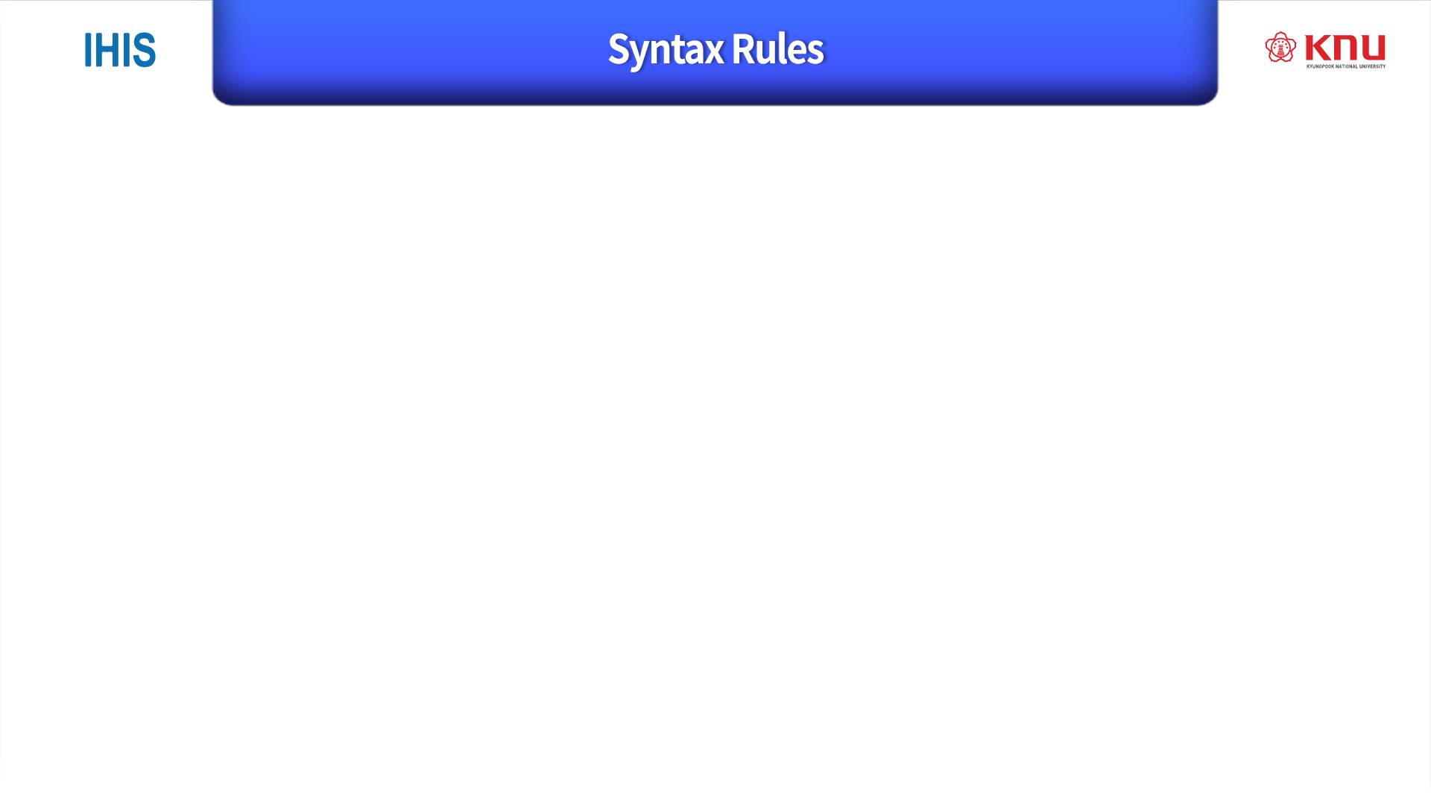
Data is written as
Name : Value pair
{“students”: [
{”name”:”Rhino”, ”major”:”Computer Science”}, {”name”:"Anna”, “major”:”Art”},
{”name”:”Peter”, “lastName”:”Statistics”}
] }
{ } holds objects
Separated by commas
[ ] holds arrays

Slide 5
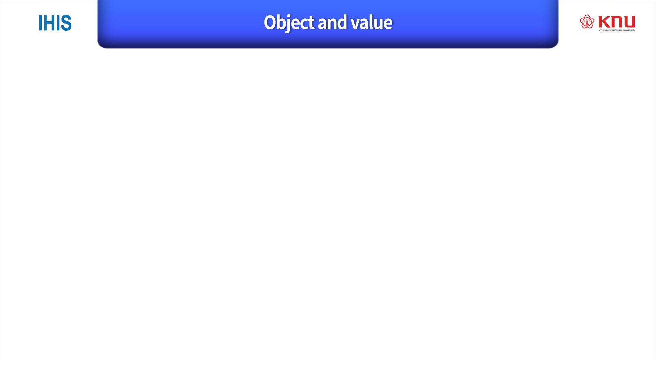
{
“name” : ”Rhino”,
Name : Value
“major” : ”Computer Science”,
“age” : 25,
“scholarship” : true
}
Object

Slide 6
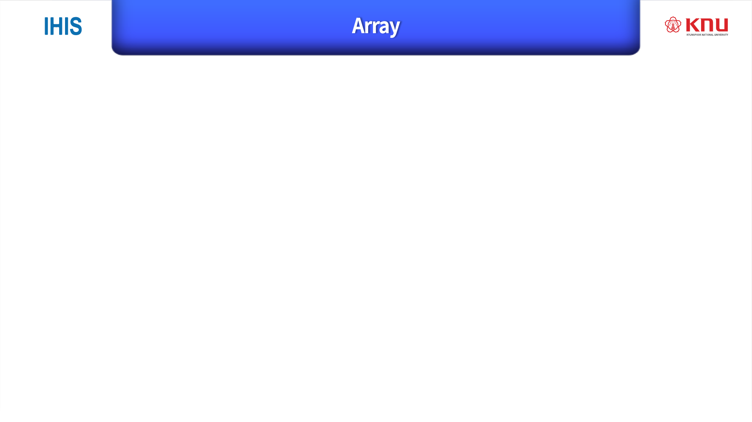
“students”: [
{”name”:”Rhino”, ”major”:”Computer Science”}, {”name”:"Anna”, “major”:”Art”},
{”name”:”Peter”, “lastName”:”Statistics”}
]
[ … ] holds arrays

Slide 7
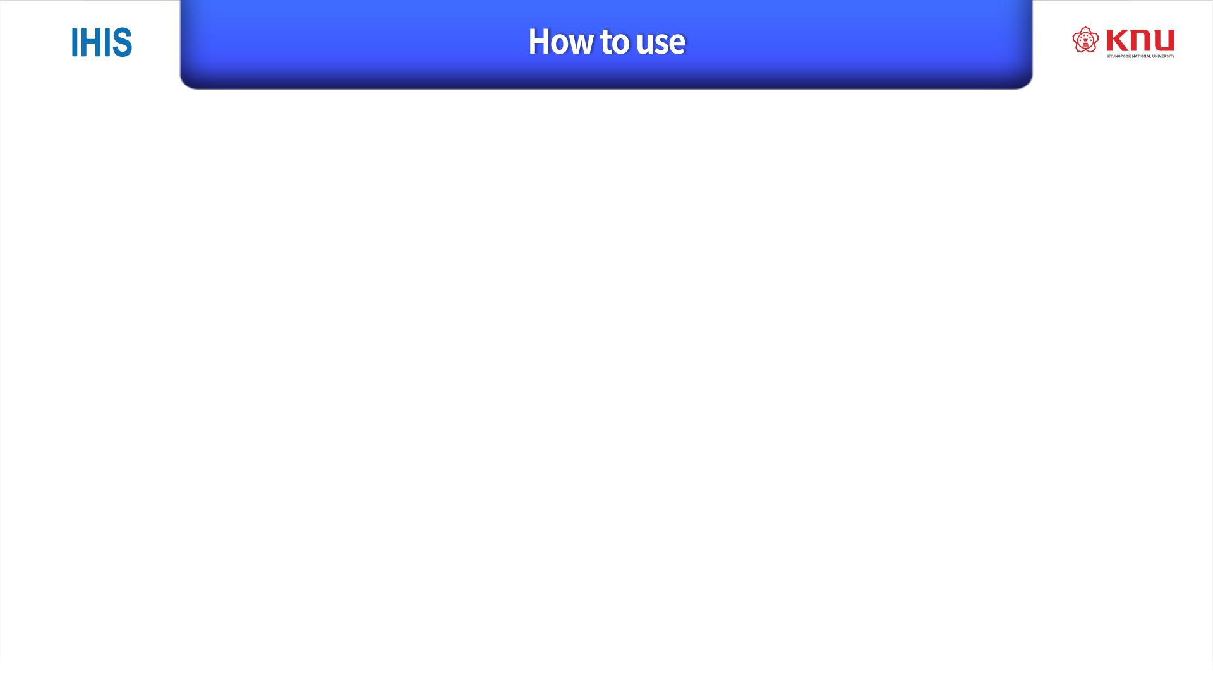

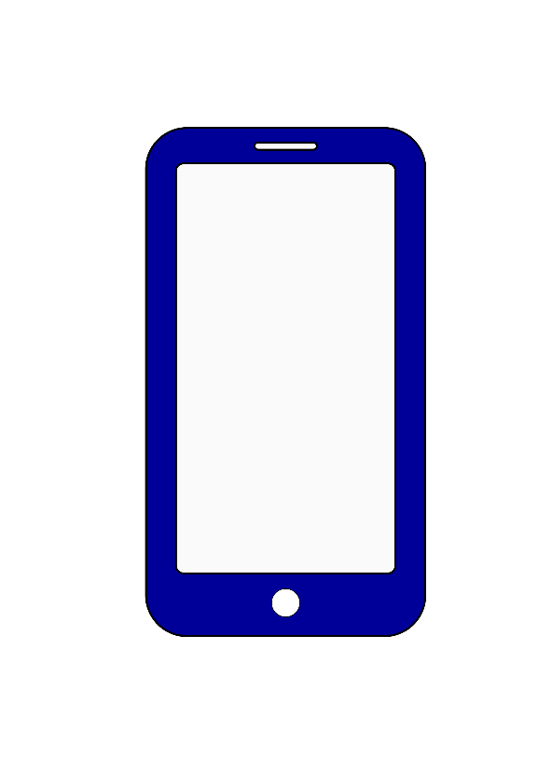
Sender
Generate JSON to make request.
Receiver
parse JSON request
Request JSON
Response JSON

Slide 8

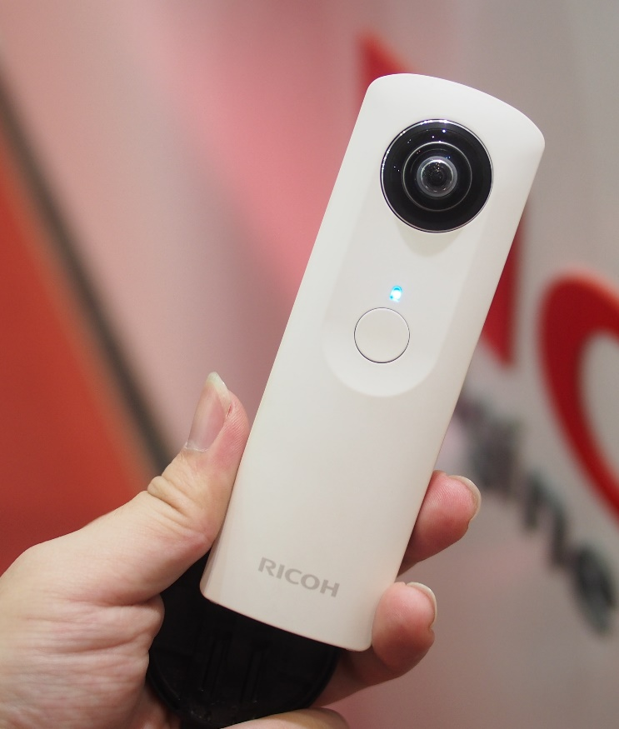
RICOH THETA S(360 degree camera)
Is connected with mobile device or computer via wireless LAN
And controlled by HTTP REST
Uses JSON to exchange data

Slide 9

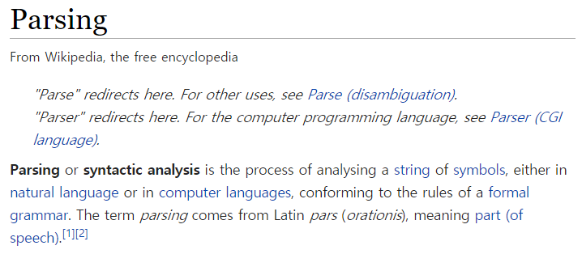

Slide 10
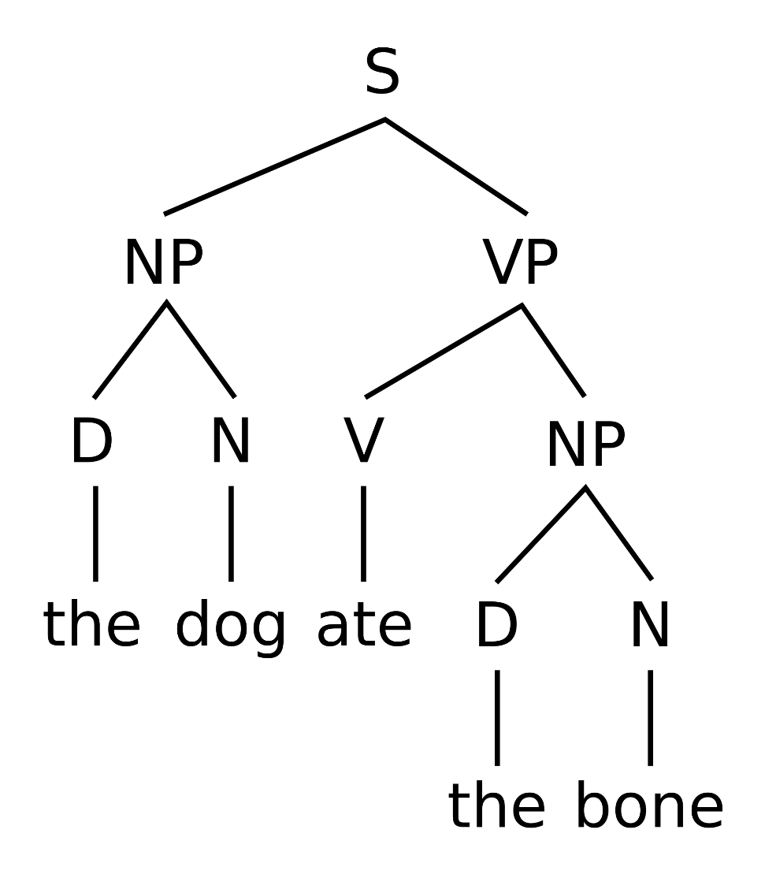
String of Symbols
Rules of formal grammar
S : Sentence
NP : Noun Phrase
VP : Verb Phrase
D : Definition article
N : Noun
V : Verb
Result

Slide 11

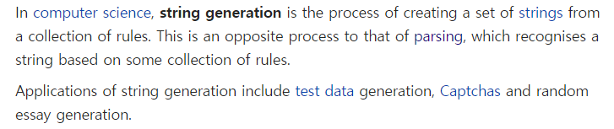

Slide 12
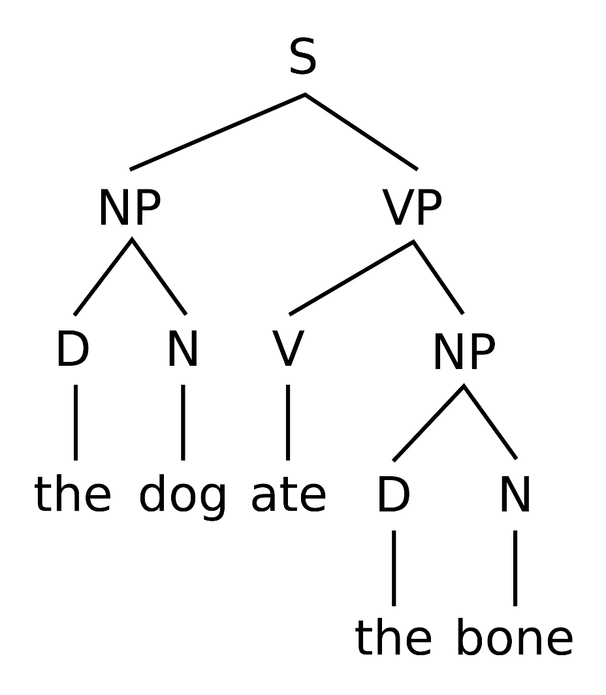
Set of Strings
Collection of Rules
S : Sentence
NP : Noun Phrase
VP : Verb Phrase
D : Definition article
N : Noun
V : Verb
Strings

Slide 13

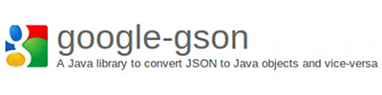

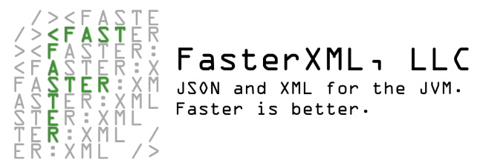


GSON (Google)
Jackson (FasterXML)
JSONP (Oracle)
JSON.simple (Yidong Fang)
JSON-lib (Douglas Crockford)
Flexjson, Json-io, Genson, JSONiJ

Slide 14
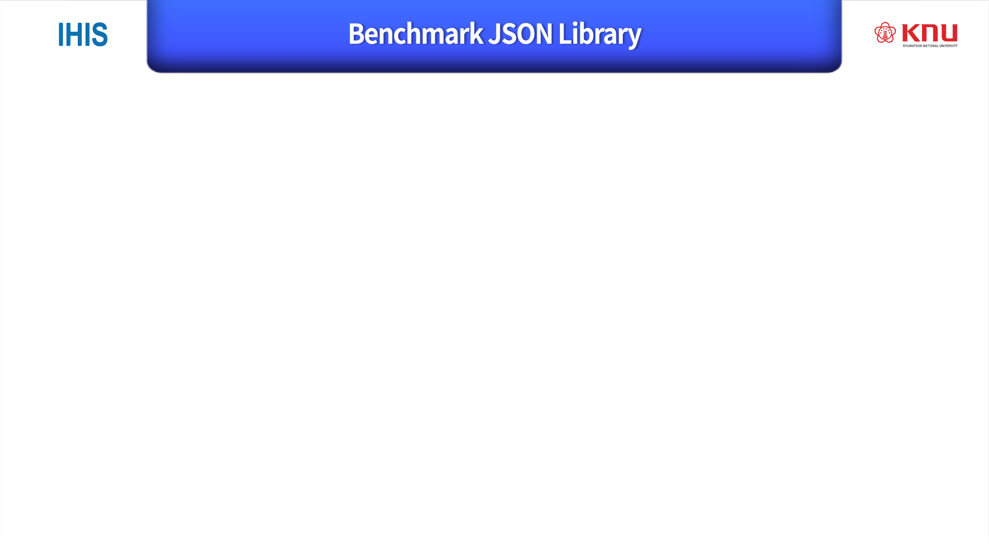
With serialization and deserialization
Serialization
Persisting an object from memory to a sequence of bits, for instance for saving onto the disk.
Deserialization
The opposite – reading data from the disk to create an object

Slide 15
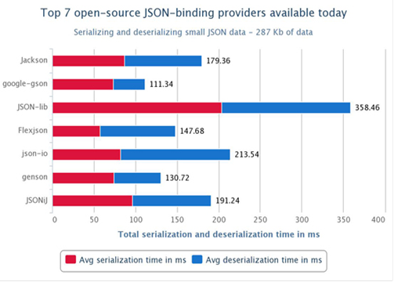

Slide 16
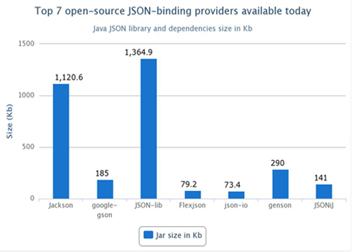

Slide 17
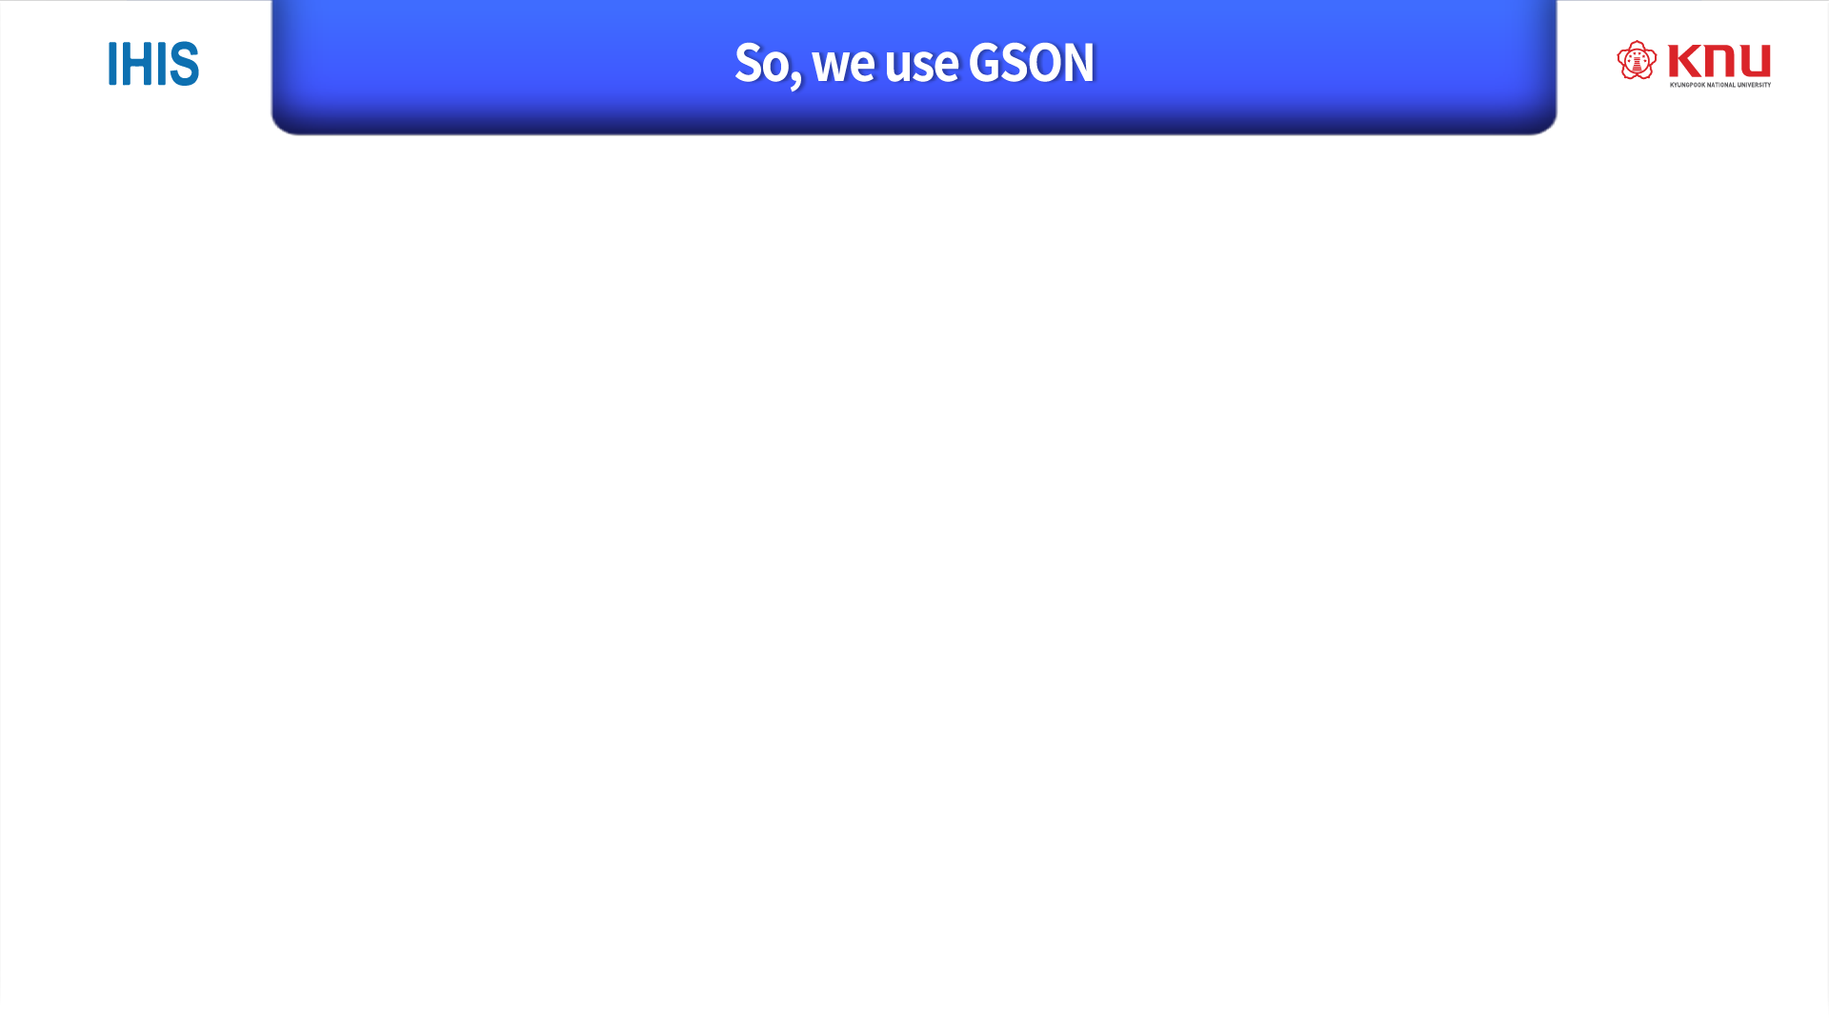
GOOGLE made
Easy to find reference and source code
Consist of one jar file
Support Maven
Best performance in small data
Nice performance on average
Light size of library and dependencies

Slide 18

Down load GSON Library from : http://search.maven.org/#artifactdetails%7Ccom.google.code.gson%7Cgson%7C2.5%7Cjar Or there’s link of latest version in README.md at https://github.com/google/gson
2. Import Library in Project
3. Code with GSON

Slide 19
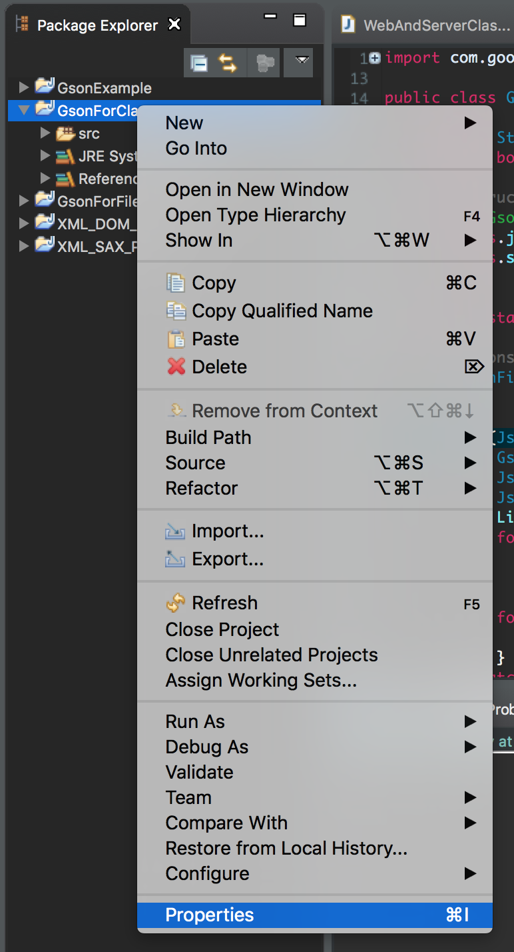
How to import Library in Project ?
Right click on you current project in Package Explorer
Click Properties

Slide 20
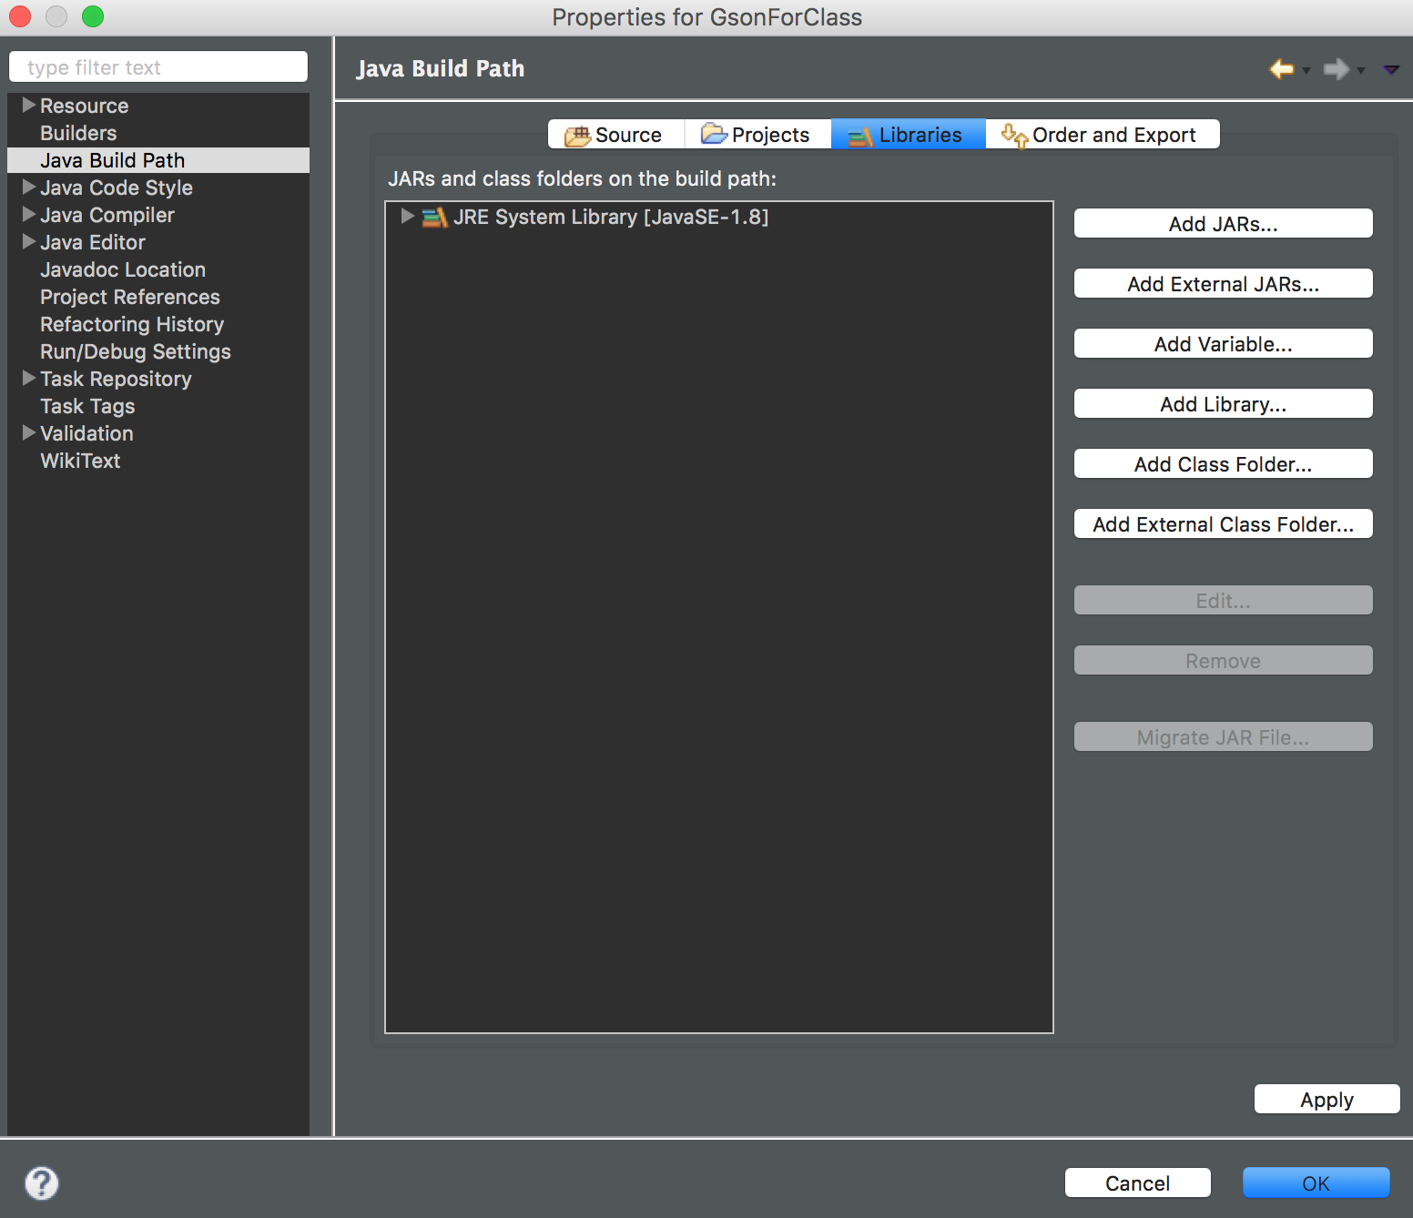
3. Go to Java Build Path tab
4. Click Add External JARs

Slide 21
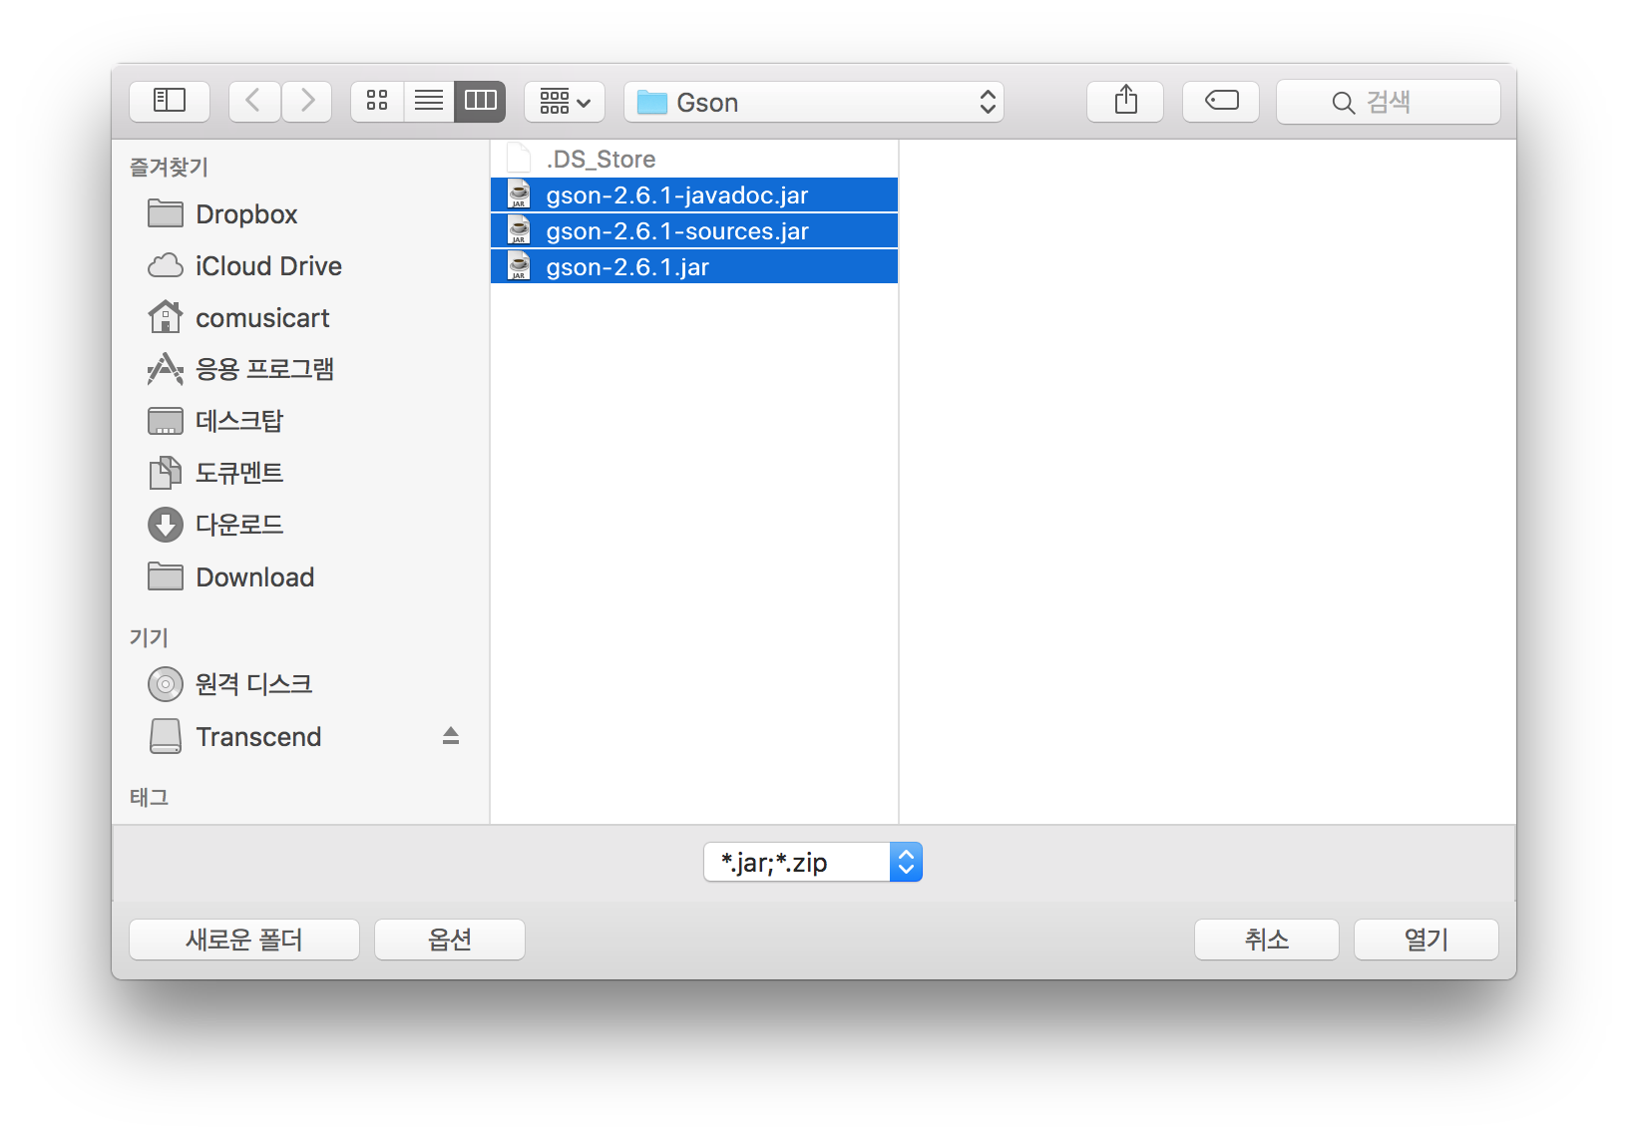
3. Go to where Gson downloaded
4. Select Jars

Slide 22
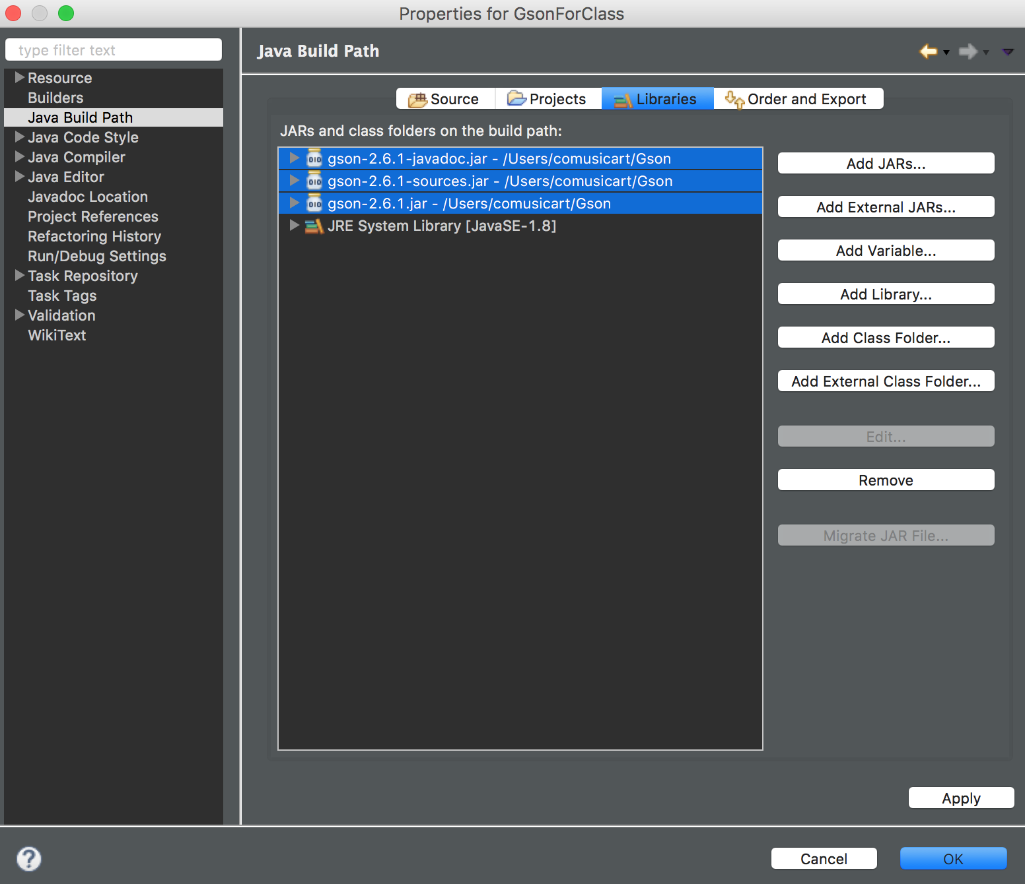
5. It might look like this after we import jars
6. Click Apply and Ok

Slide 23
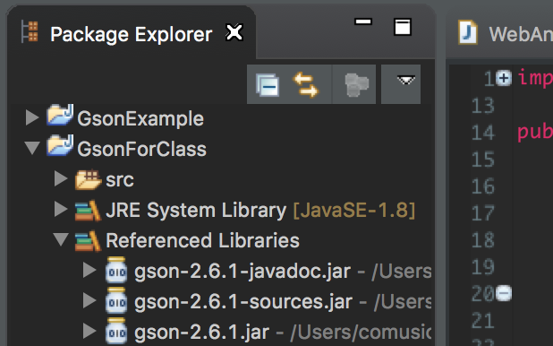
7. We can see gson is imported

Slide 24
How to code with Gson?
With Gson, It’s easy to serialize JAVA object into json format
And easy to deserialize json format into JAVA object

Slide 25

package gson;
import java.util.List;
import java.util.ArrayList;
public class WebAndServerClass {
private String code;
private List<Student> attendee;
public String getCode() {
return code;
}
public void setCode(String name) {
this.code = name;
}
public List<Student> getAttendee() {
return attendee;
}
public void setAttendee(List<Student> attendee) {
this.attendee = attendee;
}
public static class Student{
private String name;
private String grade;
private String gender;
public String getName() {
return name;
}
public void setName(String name) {
this.name = name;
}
public String getGrade() {
return grade;
}
public void setGrade(String grade) {
this.grade = grade;
}
public String getGender() {
return gender;
}
public void setGender(String gender) {
this.gender = gender;
}
public String toString() {
return "name : " + name +
"\tgrade : " + grade +
"\tgender : " + gender;
}
}

Slide 26
public static WebAndServerClass generateWASC(){
WebAndServerClass WASC = new WebAndServerClass();
WASC.setCode("COMP418001");
List<WebAndServerClass.Student> studentList = new ArrayList<Student>();
WebAndServerClass.Student student = new Student();
student = new Student();
student.setName("Rhino");
student.setGrade("Junior");
student.setGender("Male");
studentList.add(student);
student = new Student();
student.setName("Aliens");
student.setGrade("Senior");
student.setGender("Female");
studentList.add(student);
student = new Student();
student.setName("Anderson");
student.setGrade("Senior");
studentList.add(student);
student = new Student();
student.setName("AhnSang");
student.setGrade("Junior");
student.setGender("Male");
studentList.add(student);
student = new Student();
studentList.add(student);
WASC.setAttendee(studentList);
return WASC;
}
}

Slide 27

package gson;import com.google.gson.Gson;
import com.google.gson.GsonBuilder;
import java.util.List;
public class GsonTest {
public static void main(String[] args) {
WebAndServerClass WASC = WebAndServerClass.generateWASC();
System.out.printf("object to json :\n");
String objToJson = new Gson().toJson(WASC);
System.out.println(objToJson);
System.out.printf("json to object :\n");
WebAndServerClass jsonToObj = new Gson().fromJson(objToJson, WebAndServerClass.class); printObject(jsonToObj);
System.out.printf("object to json with null :\n");
String objToJsonWithNull = new GsonBuilder().serializeNulls().create().toJson(WASC); System.out.println(objToJsonWithNull);
System.out.printf("json to object with null :\n");
WebAndServerClass jsonToObjWithNull = newGson().fromJson(objToJson,WebAndServerClass.class); printObject(jsonToObjWithNull);
}

Slide 28
private static void printObject (WebAndServerClass WASC){
List<WebAndServerClass.Student> studentList = WASC.getAttendee();
System.out.println("Class code : " + WASC.getCode());
for (WebAndServerClass.Student student : studentList){
System.out.println(student);
}
}
}

Slide 29

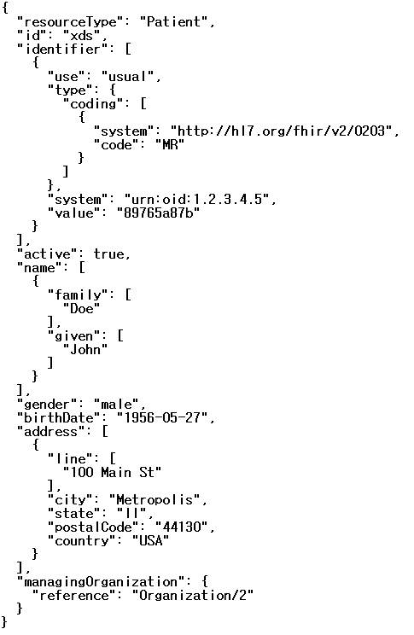
object to json :
{"code":"COMP418001","attendee":[{"name":"Rhino","grade":"Junior","gender":"Male"},{"name":"Aliens","grade":"Senior","gender":"Female"},{"name":"Anderson","grade":"Senior"},{"name":"AhnSang","grade":"Junior","gender":"Male"},{}]}
json to object :
Class code : COMP418001
name : Rhino grade : Junior gender : Male
name : Aliens grade : Senior gender : Female
name : Anderson grade : Senior gender : null
name : AhnSang grade : Junior gender : Male
name : null grade : null gender : null
object to json with null :
{"code":"COMP418001","attendee":[{"name":"Rhino","grade":"Junior","gender":"Male"},{"name":"Aliens","grade":"Senior","gender":"Female"},{"name":"Anderson","grade":"Senior","gender":null},{"name":"AhnSang","grade":"Junior","gender":"Male"},{"name":null,"grade":null,"gender":null}]}
json to object with null :
Class code : COMP418001
name : Rhino grade : Junior gender : Male
name : Aliens grade : Senior gender : Female
name : Anderson grade : Senior gender : null
name : AhnSang grade : Junior gender : Male
name : null grade : null gender : null

Slide 30
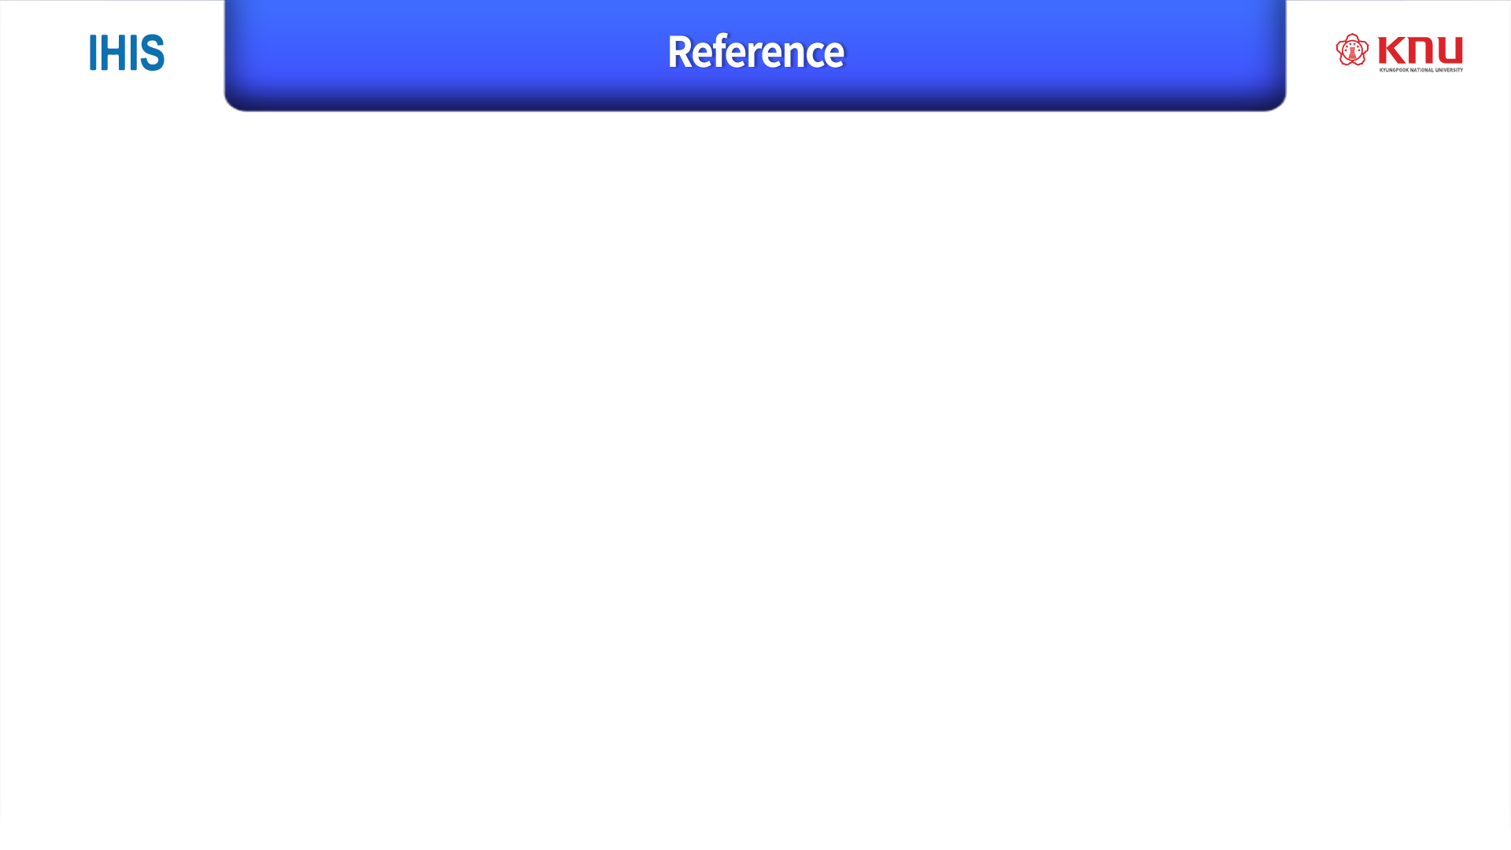
http://www.yunsobi.com/blog/646
http://www.developer.com/lang/jscript/top-7-open-source-json-binding-providers-available-today.html
http://djkeh.github.io/articles/The-fastest-way-to-parse-json-data-to-java-kor/
http://hellogk.tistory.com/7
http://stackoverflow.com/questions/3429921/what-does-serializable-mean

